Slide 1
Introduction to Python
Python is dynamically typed ,interpreted Programming language.
Python is a framework to develop s/w applications.
Python supports OOP’S concept.

Slide 2
Where we use python:
Python is used to develop s/w applications.But we so many applications like…….
Web Applications Virtual Reality
Mobile Applications Networking Applications
Automation Testing Servers
Gaming Applications Embedded Systems
Data Science(DS) VLSI etc………
Artificial Intelligence(AI)

Slide 3
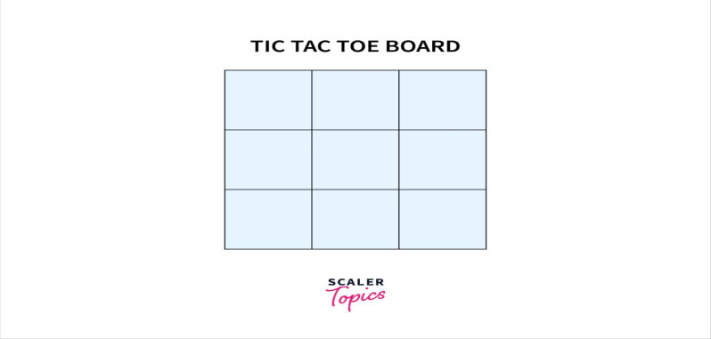
Example:
Gaming Application with
Tic –Tac-Toe
Tic-tac-toe python,also known as Noughts and Crosses or Xs and Os,is a very simple two player game where both the player get to choose any of the symbols between X and O.
It is need that Pygame to start the Tic Tac Toe game modules like numpy,pygame.
It is used Minmax algorithm.

Slide 4
We shall start by designing the tic tac toe Python grid for which we shall be using the command line interface as implementing tic tac toe in Python using CLI comes in handy.
We shall be using the user-defined function and print statements in Python.
For this, we shall be knowing about two parts that are, The Status of the Grid and The move of each player.
Then we all implement the information about the game from time to time to record what is the status of the game.

Slide 5
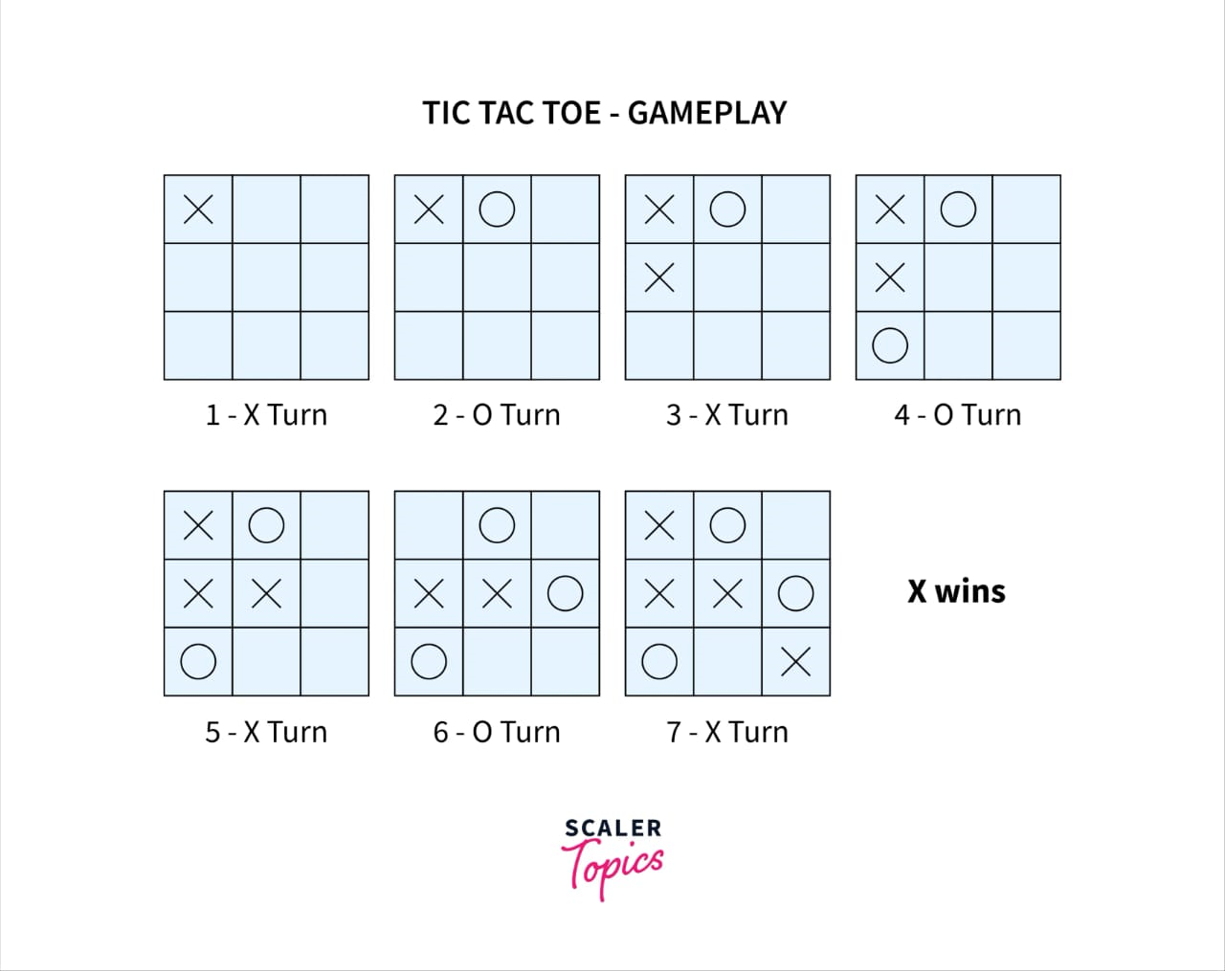

Slide 6
It's very important to mark out the win or lose situations for which we should be creating a user-defined function in Python and will be implementing if statements in Python to check if after every move the game has been won or tied by any player.
As this game is between two players our program needs to understand the same for we shall be using loops in Python to make this tic tac toe Python game give the player its chance alternatively.
Finally either Xs or Os can win the game.

Slide 7
THANK YOU

